Slide 1
More Applications of
The Pumping Lemma
Costas Busch

Slide 2


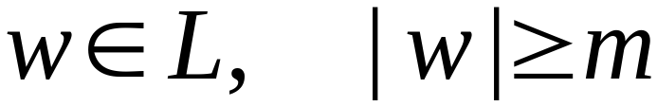

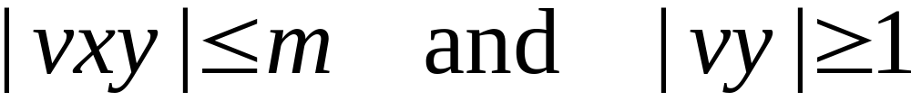
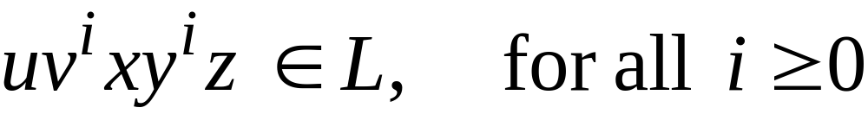
The Pumping Lemma:
For infinite context-free language
there exists an integer such that
for any string
we can write
with lengths
and it must be:
Costas Busch

Slide 3
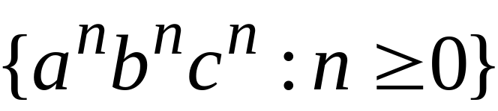
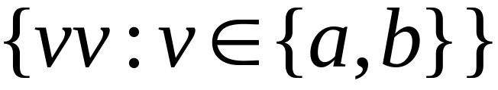

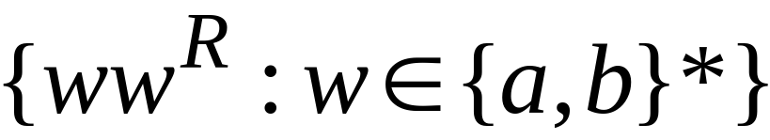
Non-context free languages
Context-free languages
Costas Busch

Slide 4
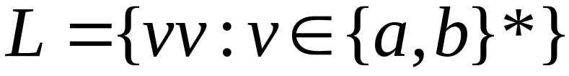
Theorem:
The language
is not context free
Proof:
Use the Pumping Lemma
for context-free languages
Costas Busch

Slide 5
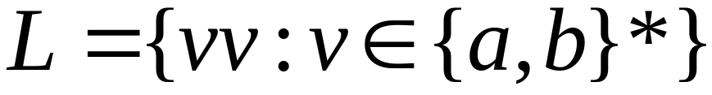
Assume for contradiction that
is context-free
Since is context-free and infinite
we can apply the pumping lemma
Costas Busch

Slide 6
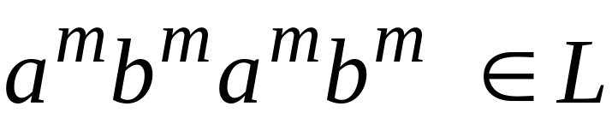
Pumping Lemma gives a magic number
such that:
Pick any string of with length at least
we pick:
Costas Busch

Slide 7
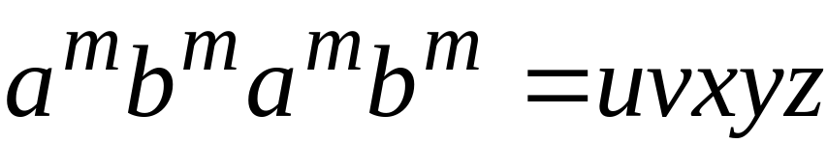
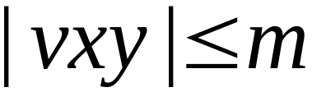
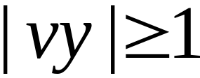
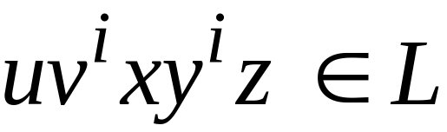

We can write:
with lengths and
Pumping Lemma says:
for all
Costas Busch

Slide 8
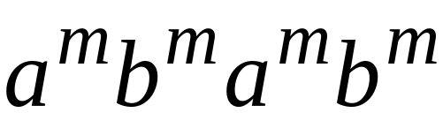

We examine all the possible locations
of string in
Costas Busch

Slide 9
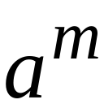
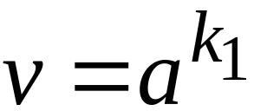
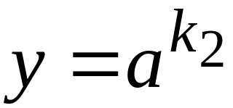
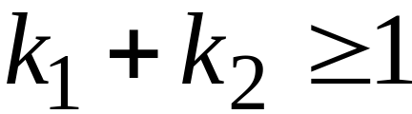





Case 1:
is within the first
Costas Busch

Slide 10
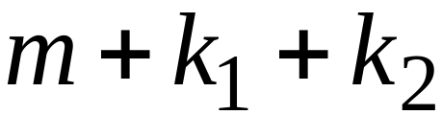
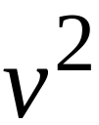
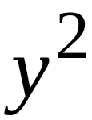
Case 1:
is within the first
Costas Busch

Slide 11
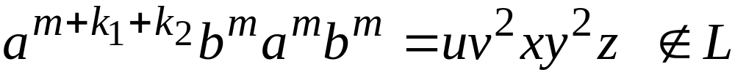
Case 1:
is within the first
Costas Busch

Slide 12
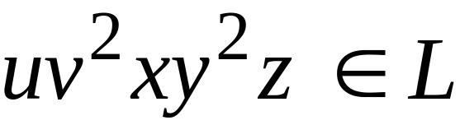
Case 1:
is within the first
However, from Pumping Lemma:
Contradiction!!!
Costas Busch

Slide 13
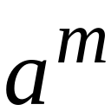
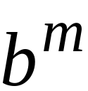
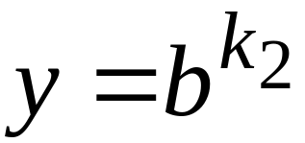
Case 2:
is in the first
is in the first
Costas Busch

Slide 14
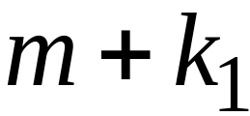
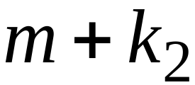
Case 2:
is in the first
is in the first
Costas Busch

Slide 15
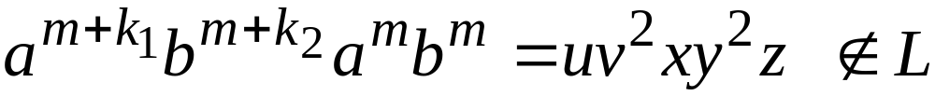
Case 2:
is in the first
is in the first
Costas Busch

Slide 16
Case 2:
is in the first
is in the first
However, from Pumping Lemma:
Contradiction!!!
Costas Busch

Slide 17
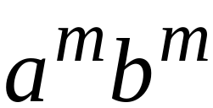
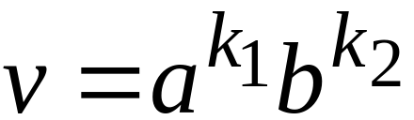
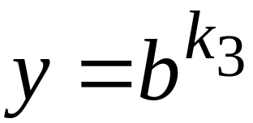
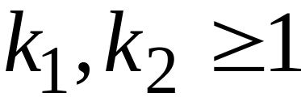
Case 3:
overlaps the first
is in the first
Costas Busch

Slide 18


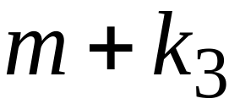
Case 3:
overlaps the first
is in the first
Costas Busch

Slide 19
Case 3:
overlaps the first
is in the first
Costas Busch

Slide 20
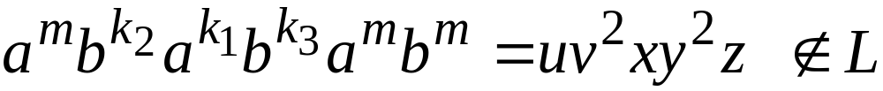
Case 3:
overlaps the first
is in the first
However, from Pumping Lemma:
Contradiction!!!
Costas Busch

Slide 21
Case 4:
in the first
Overlaps the first
Analysis is similar to case 3
Costas Busch

Slide 22
Other cases:
is within
or
or
Analysis is similar to case 1:
Costas Busch

Slide 23
More cases:
overlaps
or
Analysis is similar to cases 2,3,4:
Costas Busch

Slide 24
There are no other cases to consider
Since , it is impossible
to overlap:
nor
nor
Costas Busch

Slide 25
In all cases we obtained a contradiction
Therefore:
The original assumption that
is context-free must be wrong
Conclusion:
is not context-free
Costas Busch

Slide 26
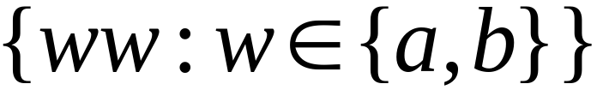
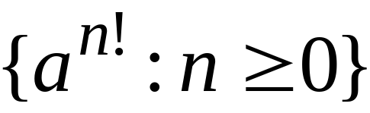
Non-context free languages
Context-free languages
Costas Busch

Slide 27
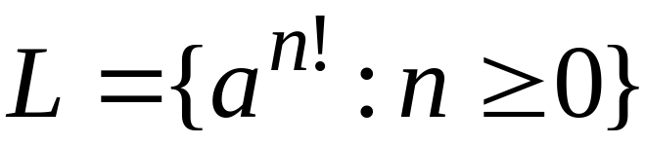
Theorem:
The language
is not context free
Proof:
Use the Pumping Lemma
for context-free languages
Costas Busch

Slide 28
Assume for contradiction that
is context-free
Since is context-free and infinite
we can apply the pumping lemma
Costas Busch

Slide 29
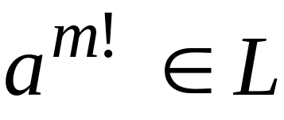
Pumping Lemma gives a magic number
such that:
Pick any string of with length at least
we pick:
Costas Busch

Slide 30
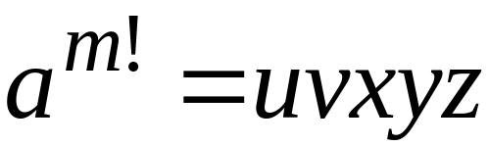
We can write:
with lengths and
Pumping Lemma says:
for all
Costas Busch

Slide 31
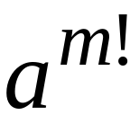
We examine all the possible locations
of string in
There is only one case to consider
Costas Busch

Slide 32


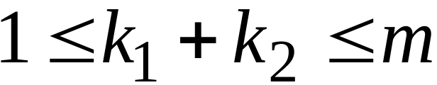
Costas Busch

Slide 33
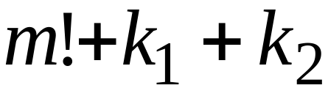

Costas Busch

Slide 34

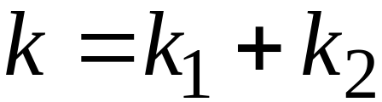

Costas Busch

Slide 35
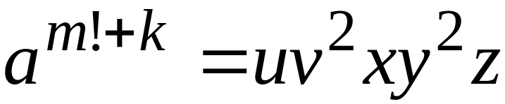
Costas Busch

Slide 36

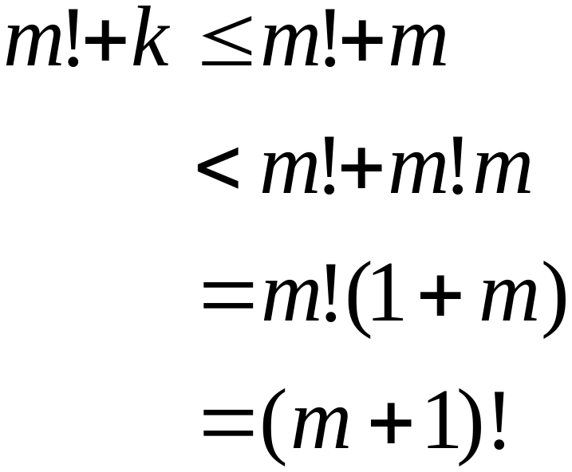
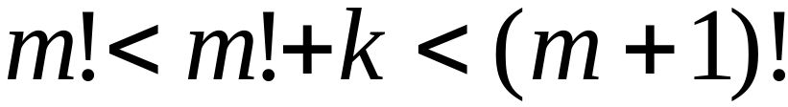
Since , for we have:
Costas Busch

Slide 37
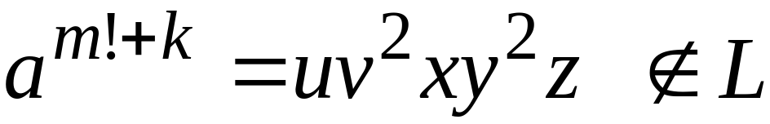
Costas Busch

Slide 38
However, from Pumping Lemma:
Contradiction!!!
Costas Busch

Slide 39
We obtained a contradiction
Therefore:
The original assumption that
is context-free must be wrong
Conclusion:
is not context-free
Costas Busch

Slide 40
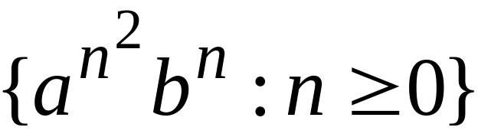
Non-context free languages
Context-free languages
Costas Busch

Slide 41
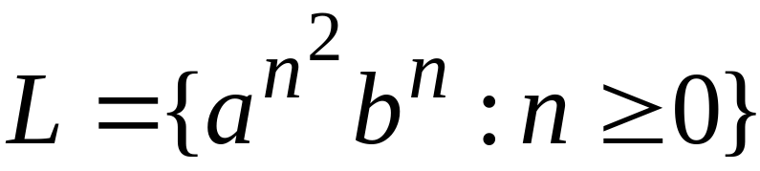
Theorem:
The language
is not context free
Proof:
Use the Pumping Lemma
for context-free languages
Costas Busch

Slide 42
Assume for contradiction that
is context-free
Since is context-free and infinite
we can apply the pumping lemma
Costas Busch

Slide 43

Pumping Lemma gives a magic number
such that:
Pick any string of with length at least
we pick:
Costas Busch

Slide 44

We can write:
with lengths and
Pumping Lemma says:
for all
Costas Busch

Slide 45

We examine all the possible locations
of string in
Costas Busch

Slide 46


Most complicated case:
is in
is in
Costas Busch

Slide 47
Costas Busch

Slide 48


Most complicated sub-case:
and
Costas Busch

Slide 49





Most complicated sub-case:
and
Costas Busch

Slide 50

Most complicated sub-case:
and
Costas Busch

Slide 51


and
Costas Busch

Slide 52

Costas Busch

Slide 53

However, from Pumping Lemma:
Contradiction!!!
Costas Busch

Slide 54
When we examine the rest of the cases
we also obtain a contradiction
Costas Busch

Slide 55
In all cases we obtained a contradiction
Therefore:
The original assumption that
is context-free must be wrong
Conclusion:
is not context-free
Costas Busch

